Slide 1
LAB: Building AI apps with PostgreSQL
Abe Omorogbe

Slide 2
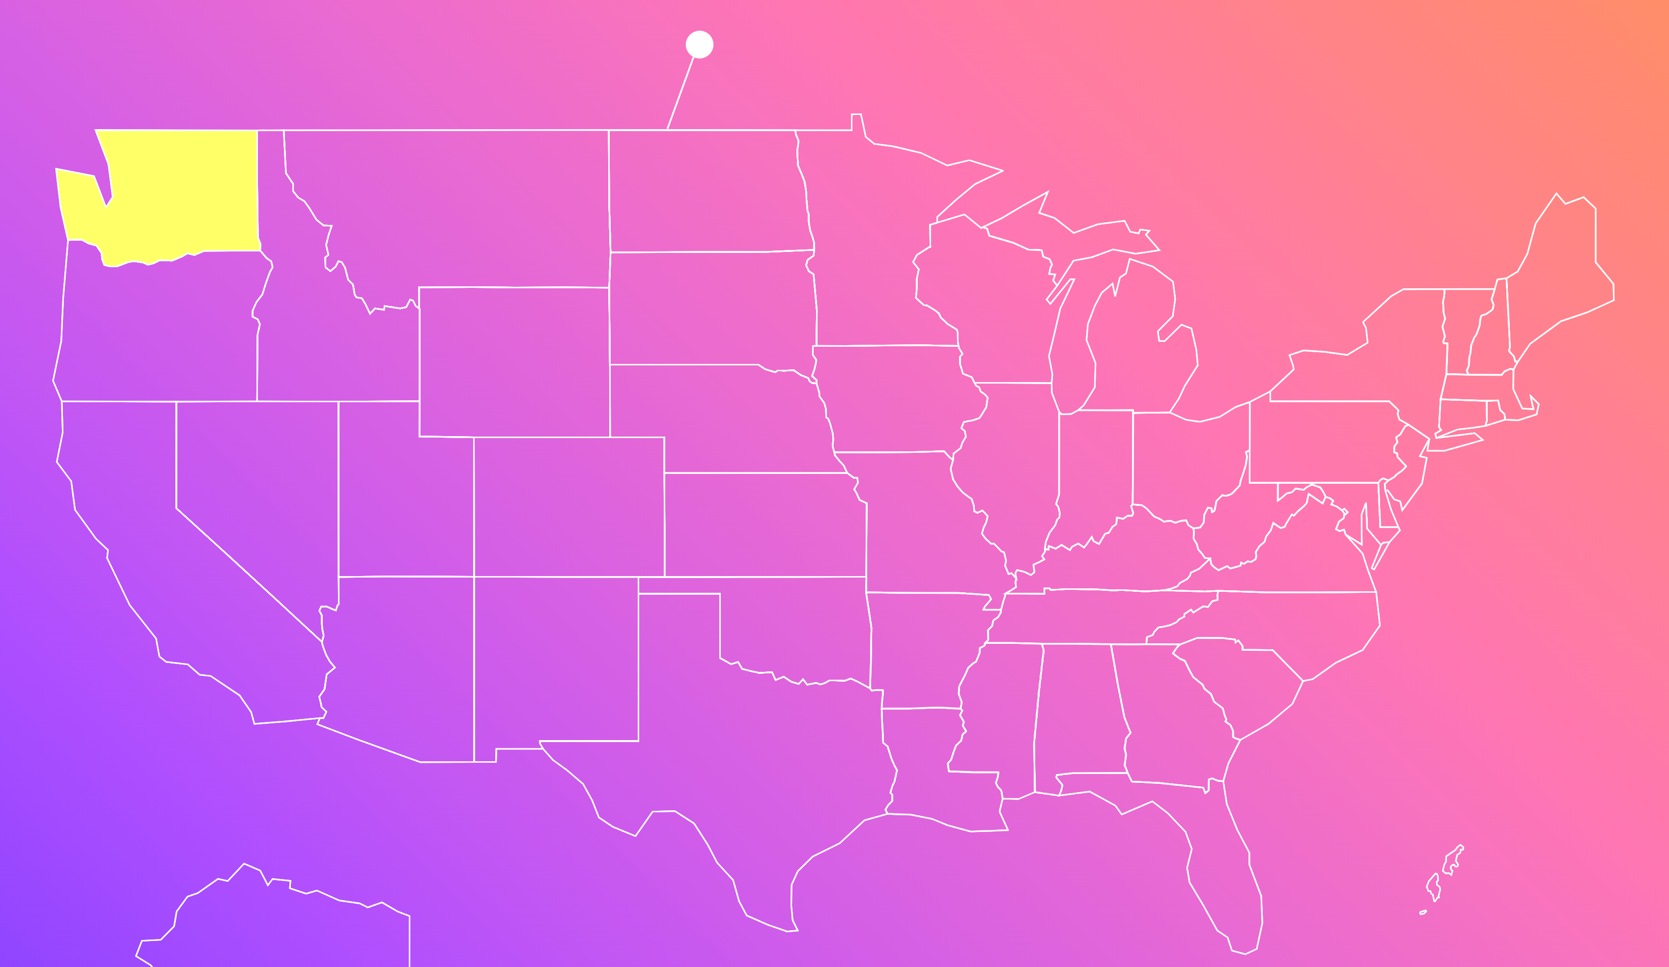

Lab Agenda – Find Relevant Cases
5
Search context – Semantic Search
Re-ranker and GraphRAG
3
RAG App
4
Search context –
Pattern Matching
2
US Caselaw Dataset
1

Slide 3
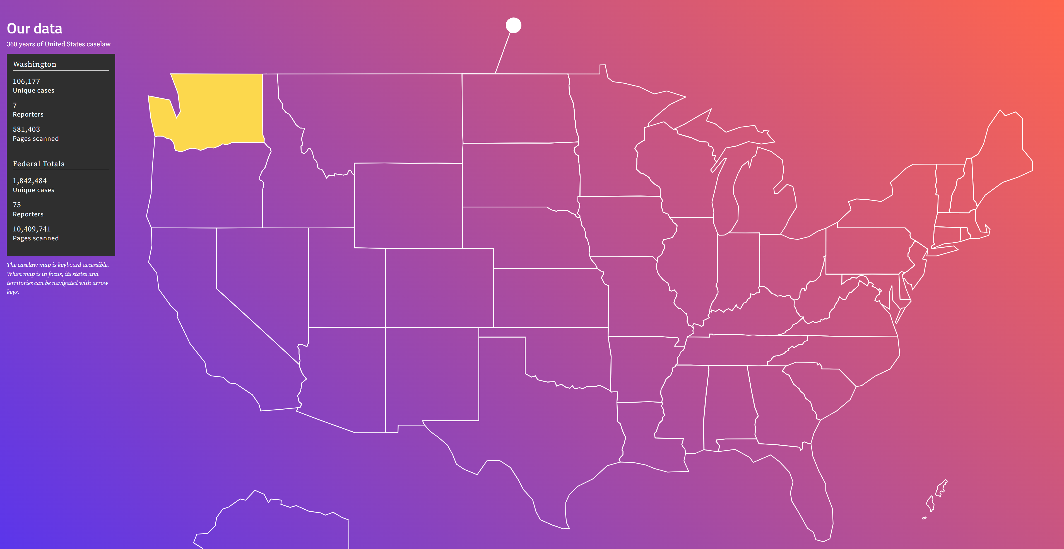
Story Premise
You’re a legal researcher or lawyer focusing on cases in Washington state.
You’re working on a tenant rights and property dispute case in Washington and need previous, similar cases to support your arguments.
Ideally, the cases should involve situations like property damage, tenant disputes, and landlord liability, and be contextually related, not just keyword-matched.
Notes:
This is where Azure databases come into play.
Users can have a single database for their operational/ transactional data and their vector data together. It is an all in one database, to save on cost and complexity.
For example, if you use a third-party single purpose database, such as Pinecone, you will have to ETL out of the transactional data stores, and put it in their database, and surface that for vector queries, and RAG pattern and then bring the data back.
However, this method has some limitations, especially if your data high volatility. Third-party databases like Pinecone aren't best suited for such rapidly changing information because there is always a lag in updating and querying the data. This delay means that the data you're analyzing is already outdated by the time it's ready for use.
Therefore, going with the first party service is going to give you a better experience with real time AI, which is quite straightforward, potentially cost less and the best integrations with other azure services.
We are the only database at Microsoft that provides built-in AI functionality including vector search capability in our Azure Database for PostgreSQL this vector capability allows devs to query their data to implement Gen AI/ RAG type applications. We are also the only database service that provides SLA over our performance. You can get SLAs for 4 9s of availability.

Slide 4


How can Postgres help?
With PostgreSQL’s advanced vector capabilities and AI-driven features like RAG, we can perform powerful, context-aware searches within the Washington state caselaw dataset.
Let’s walk through the journey of transforming basic legal keyword search into a sophisticated, contextually relevant search solution.

Slide 5
Lab Agenda – Find Relevant Cases
5
3
4
2
US Caselaw Dataset
1

Slide 6



Caselaw Dataset (Washington State)
106,177 unique cases
7 legal reporters
581,403 pages scanned
https://case.law/caselaw/#washington

Slide 7

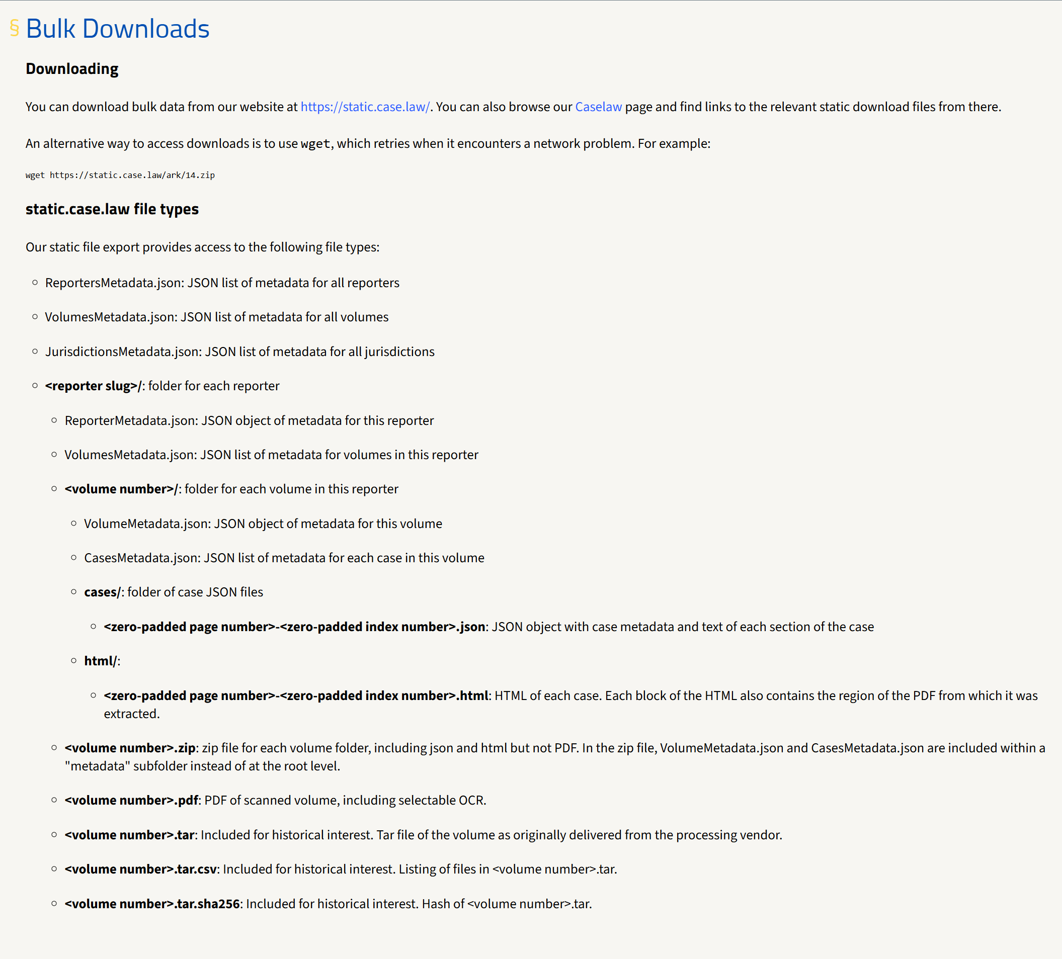
Dataset
cases.csv
includes all official, book-published state and federal United States case law through 2020

Slide 8
Lab Agenda – Find Relevant Cases
Search context –
Similarity
2
US Caselaw Dataset
1
Notes:
Make this more descriptive:
And sets the expectations.
Show a visual with growth of search:
All the way to to Sematic -> Reranker and Graph.
Add Semantic Reranker
Add Graph RAG – Give them the query

Slide 9
Search Pattern
Let's start by using Postgres’s “ILIKE” for pattern matching.
Search reviews to see if they mention words like ‘%tenant%’ and ‘%property%’.
WHERE summary ILIKE ‘%tenant%’ -- Searching for cases mentioning ‘tenant’ AND summary ILIKE ‘%property%’ -- Searching for cases mentioning ‘property’

Slide 10
Search Pattern
This approach is simple but has limitations when it comes to complex phrases or contextual search.
WHERE summary ILIKE '%water leaking apartment from the floor above%’;
-- Search for listings in review text

Slide 11
Search Phrase – FULL TEXT
Next, we use PostgreSQL’s FULL TEXT search capabilities.
Full-text search helps us find phrases like ‘tenant’ or ‘property’.
WHERE opinion_text@@ to_tsquery('english’, ‘tenant | property’) -- Search for "tenant" OR "property"

Slide 12
Search Phrase – FULL TEXT
This is better for phrase-based searches but struggles with nuanced queries like
WHERE opinion_text@@ to_tsquery('english’, ‘water leaking apartment from the floor above’) -- Attempting full-text search with a phrase

Slide 13
Lab Agenda – Find Relevant Cases
Vectors 101
Search context –
Pattern Matching
2
US Caselaw Dataset
1
Notes:
Make this more descriptive:
And sets the expectations.
Show a visual with growth of search:
All the way to to Sematic -> Reranker and Graph.
Add Semantic Reranker
Add Graph RAG – Give them the query

Slide 14
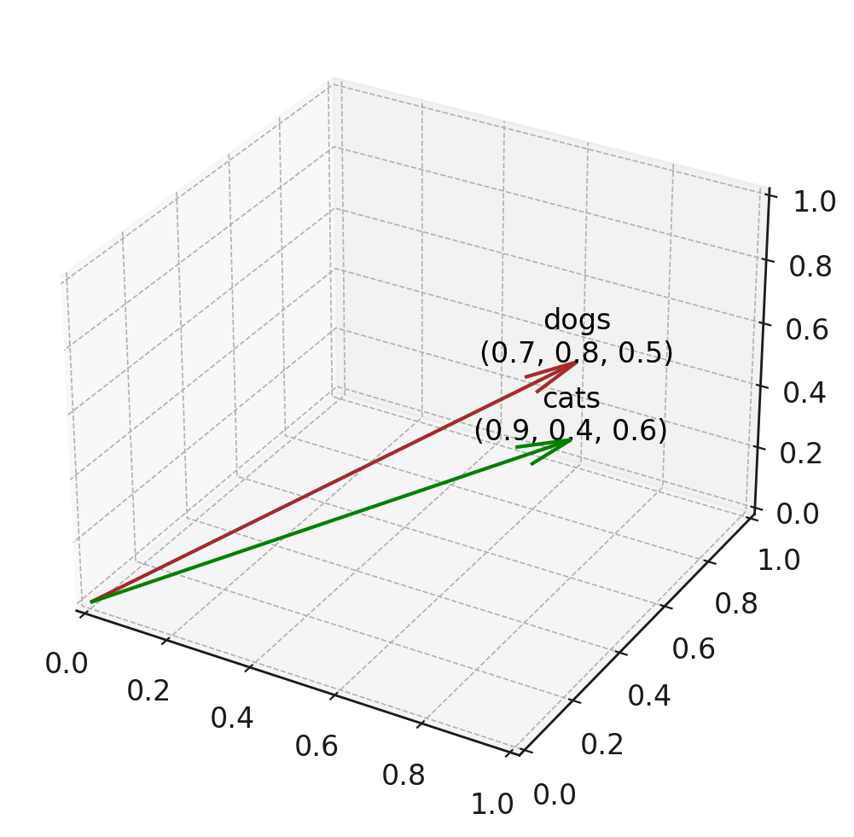
Vector 101
Lists of numbers that represent items in a high-dimensional space.
For example, a vector representing the string “dogs" might be [0.7, 0.8, 0.5].
Each number in the vector is a dimension of the space.
Notes:
OVERVIEW OF VECTORS
A vector are lists of numbers (floating point). This list represents an item in a high-dimensional space. For instance, a vector for the word 'coffee' might look like [0.3, 0.8, 0.5].
In the graph shown, there are three-dimensional vectors, but typically vectors have much higher dimensions, which are harder to visualize.
For example, we could generate a vector for the string ‘dog,' and compare it to a vector for ‘cat.’ Each number in a vector is considered a dimension in space.
Often, we don't know what each number represents specifically, but they form a representation in vector space.

Slide 15
Generating vectors
Use a model to generate vectors for items:
Input | → | Model | → | Vector
"dog" |  | word2vec |  | [0.017198, -0.007493, -0.057982, ..]
"cat" |  | word2vec |  | [0.004059, 0.06719, -0.093874, ...]
Model | Input types | Dimensions
Word2Vec | Word | 50-300
OpenAI text-embedding-ada-002 | Text | 1536
OpenAI text-embedding-3 | Text | 256-3072
Azure Computer Vision Multi-modal | Text or Image | 1024
Popular models (find more on HuggingFace):
Notes:
POPULAR MODELS FOR GENERATING EMBEDDINGS
Models like WORD2VEC can be used to generate embeddings (vectors) for single words, returning a list of floating-point numbers.
Other advance models (OPEN AI) take larger inputs and generate vectors of varying dimensions.
word2vec: Takes a single word and outputs vectors of dimensions between 50 and 300.
OpenAI models: Can take longer text (up to 8192 tokens) and generate vectors with dimensions that vary between 256 and 3072.
Many other models are available (e.g., from Hugging Face), and there's a leaderboard that compares model performance on different datasets.

Slide 16
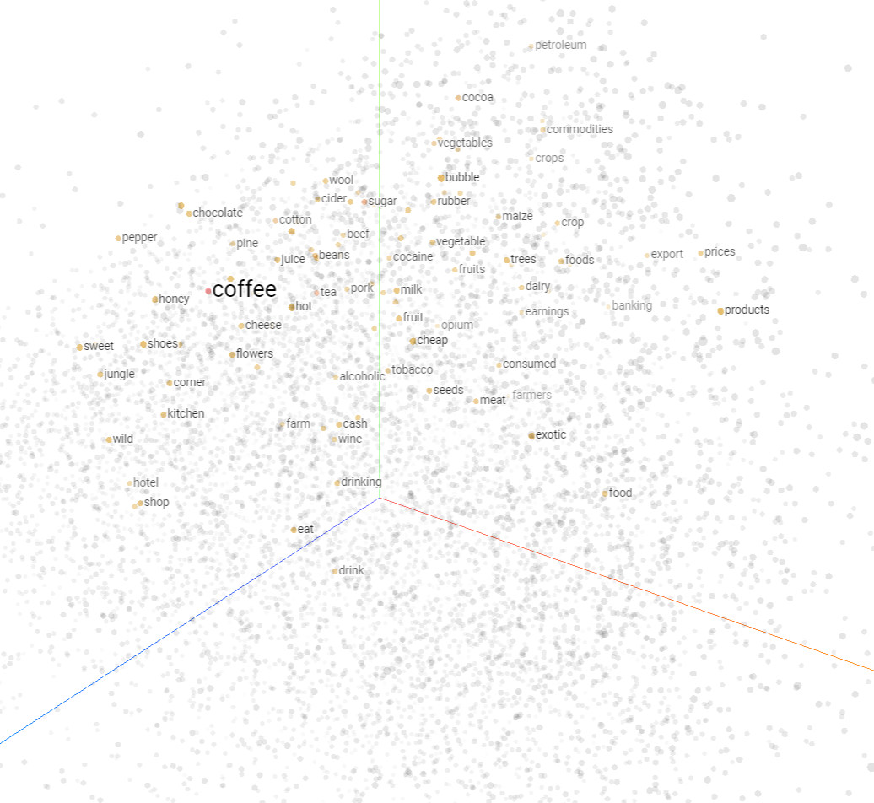
So why should we care about vectors embeddings?
Similarity
Find similar items in a large dataset, useful for recommendations
Notes:
WHY USE VECTOR EMBEDDINGS?
Similarity: Vectors allow us to measure how similar two items are, which is useful for recommendations, fraud detection, etc.
Search: You can take an arbitrary input, convert it into a vector, and use it to find similar items.
We can build both similarity and search algorithms using vectors.

Slide 17
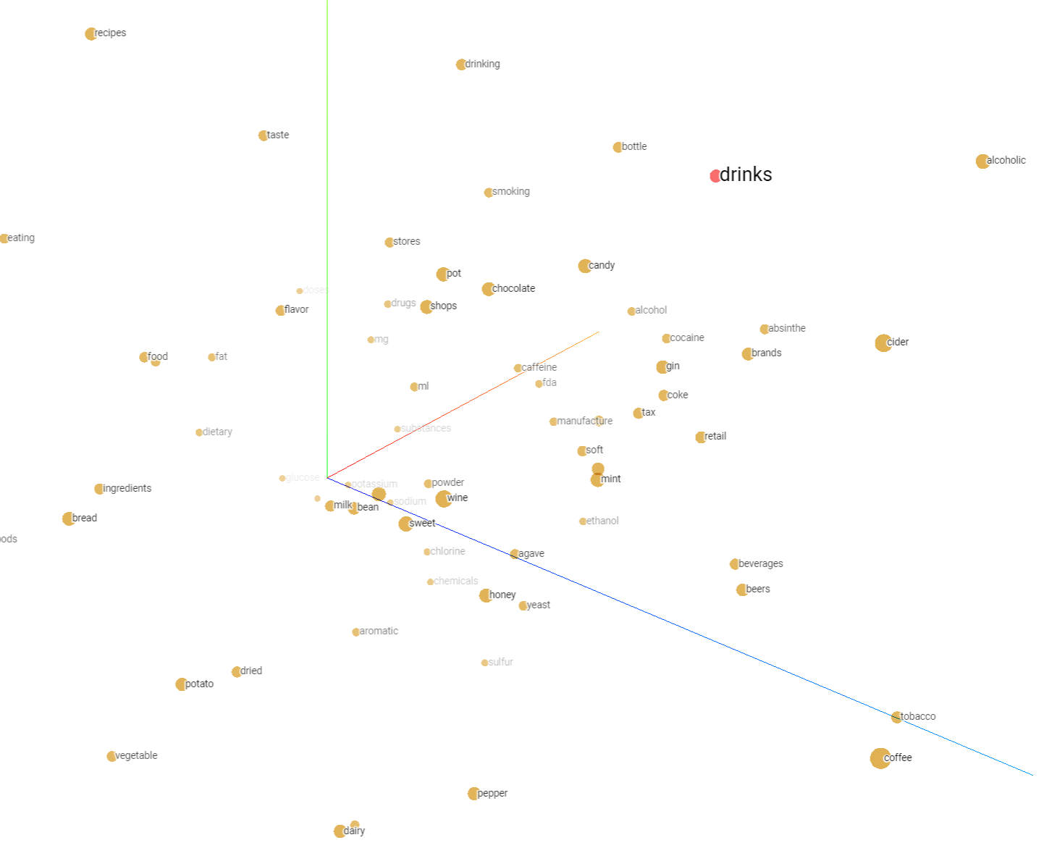
So why should we care about vectors embeddings?
Search
Search other items that are similar to what
you’re querying.
Notes:
WHY USE VECTOR EMBEDDINGS?
Similarity: Vectors allow us to measure how similar two items are, which is useful for recommendations, fraud detection, etc.
Search: You can take an arbitrary input, convert it into a vector, and use it to find similar items.
We can build both similarity and search algorithms using vectors.

Slide 18
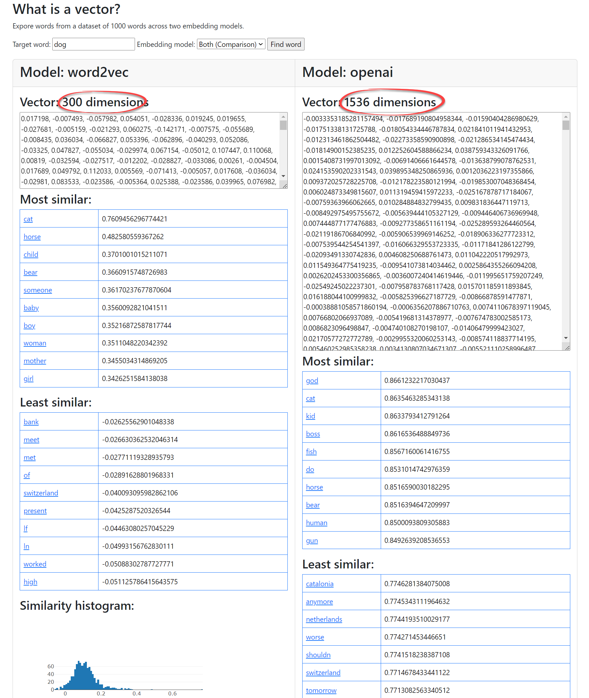
Example
Generate Vector
https://pamelafox.github.io/vectors-comparison/
Notes:
TOOLS TO UNDERSTAND VECTORS
GENERATE - One tool visualizes vectors from different models (e.g., word2vec, OpenAI).
Word2vec vectors often focus on semantics (e.g., 'dog' and 'cat' are close because they are both pets).
OpenAI vectors may encode other aspects, such as syntax or spelling.
VISUALIZE - Another tool (projector.tensorflow.org) visualizes high-dimensional vectors in 3D using Principal Component Analysis (PCA).
NOTE: Reducing high-dimensional vectors to 3D doesn't capture all complexity but is a helpful visualization technique.

Slide 19
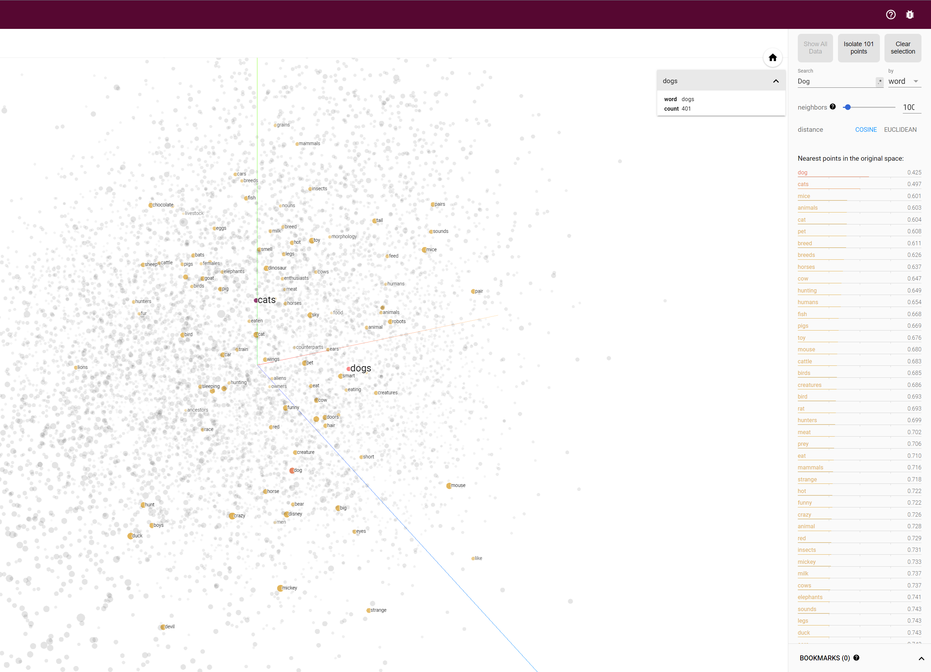
Example:
Visualize Vector
https://projector.tensorflow.org/
Notes:
TOOLS TO UNDERSTAND VECTORS
GENERATE - One tool visualizes vectors from different models (e.g., word2vec, OpenAI).
Word2vec vectors often focus on semantics (e.g., 'dog' and 'cat' are close because they are both pets).
OpenAI vectors may encode other aspects, such as syntax or spelling.
VISUALIZE - Another tool (projector.tensorflow.org) visualizes high-dimensional vectors in 3D using Principal Component Analysis (PCA).
NOTE: Reducing high-dimensional vectors to 3D doesn't capture all complexity but is a helpful visualization technique.

Slide 20
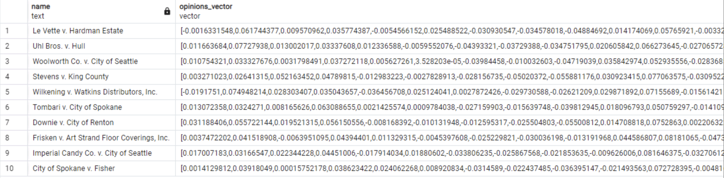
Storing vectors in Postgres table
Notes:
STORING VECTORS IN POSTGRESQL
- To use vectors in PostgreSQL, you first need to install the pgvector extension.

Slide 21







Vectors: Important in the AI Era
1, 3, 5, 4, ..
2, 8, 1, 0, ..
9, 2, 5, 6, ..
Raw Data
Deep Learning Model
High-dimensional Vectors
Vector Similarity Search
Vector similarity search empowers Generative AI apps
Recommendation
Question Answering
RAG apps

Slide 22




AI Services integrated into Azure Postgres
Make remote calls directly from PostgreSQL
azure_ai extension
Exceptional simplicity out of the box
Azure OpenAI
Azure AI Language Services
Azure AI Translator
Azure Machine Learning
Enables developers to rapidly adopt new AI capabilities in their solution without complex re-architecture or refactoring
Azure OpenAI
Azure Database for PostgreSQL
Azure AI
Language Services
Azure AI Translator
Azure Machine Learning

Slide 23
In-Database Embedding Models
Low-latency embedding creation for OLTP workloads
Data Privacy, data doesn’t leave database
Lower latency and higher throughput
Cost predictability

Slide 24
Vector Search in Azure Database for Postgres
pgvector extension
Storing and indexing vectors alongside relational data
Various indexing & retrieval strategies
Combine vector queries with metadata filters
Access control and other relational DB features work with vectors
Generative AI apps
RAG (Retrieval Augmented Generation) apps
Retrieve private data to ground LLM model responses
Recommendation/Semantic Search
Retrieve similar documents by distance between vectors
Hybrid Search
Combine vector search, row filtering, and full-text search

Slide 25




Vector Search in Azure Database for Postgres
Unique Remote + In-Database Embedding Models
Remote Embedding Models
SELECT * FROM <table>
ORDER BY
database_description <->
azure_openai.create_embeddings(
‘text-embedding-ada-002’,
‘Databases with vector support’)
“Databases with vector support”
0.001238432, …
Application
Azure Database for PostgreSQL
Azure OpenAI Embedding Models
In-Database Embedding Models (Preview)
SELECT * FROM <table>
ORDER BY
recipe_embedding <#>
azure_local_ai.create_embeddings(
‘multilingual-e5-small:v1’,
‘Databases with vector support’)
“Databases with vector support”
Local Embedding Models
(Running in Postgres)
0.001238432, …
Application
Azure Database for PostgreSQL

Slide 26
Lab Agenda – Find Relevant Cases
Search context – Semantic Search
3
Search context –
Pattern Matching
2
US Caselaw Dataset
1
Notes:
Make this more descriptive:
And sets the expectations.
Show a visual with growth of search:
All the way to to Sematic -> Reranker and Graph.
Add Semantic Reranker
Add Graph RAG – Give them the query

Slide 27
Vector Search – Semantic Search
Now, let’s dive into semantic search using vector data
With Azure OpenAI embeddings and PostgreSQL vectors, we can search reviews using natural language queries like: “House with a beach view and pet-friendly”
ORDER BY r.description_vector <=> azure_openai.create_embeddings('text-embedding-3-small’,’Water leaking apartment from the floor above ')::vector
-- Perform vector similarity search using Azure OpenAI embeddings.
-- This searches for reviews “similar to” the input phrase: ‘House with a beach view and pet-friendly’.

Slide 28
DEMO Vector Search - Semantic Search

Slide 29
Lab Agenda – Find Relevant Cases
Search context – Semantic Search
3
RAG App
4
Search context –
Pattern Matching
2
US Caselaw Dataset
1

Slide 30
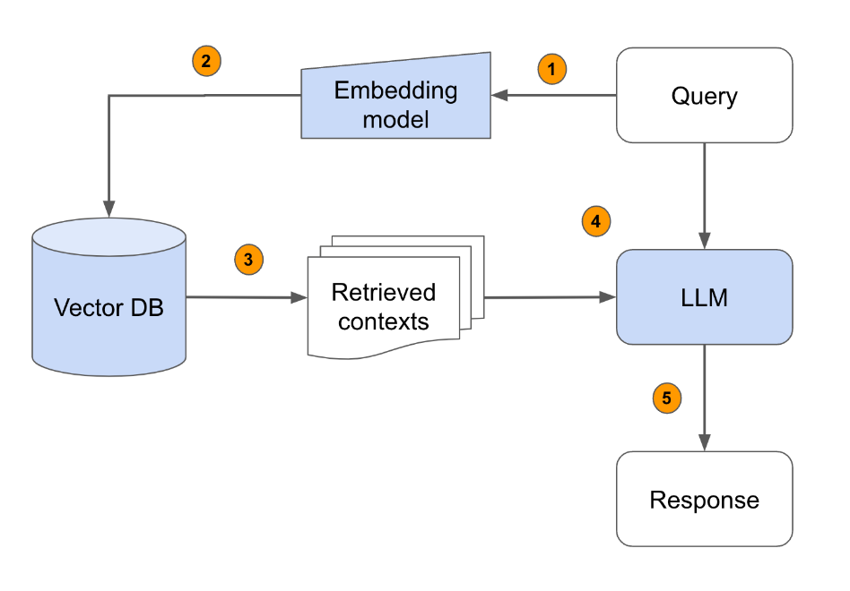
What is RAG?
RAG is the process of retrieving relevant contextual information from a data source and passing that information to a large language model alongside the user’s prompt.
Azure OpenAI Embedding Model
User's Search Query
Relevant Cases
OpenAI LLM (GPT-4o)
Final Cases Recommendation

Slide 31
DEMO E2E RAG
Notes:
https://abeomorogbe-graphra-ca.gentledune-632d42cd.eastus2.azurecontainerapps.io/
Redeploy with: Blog: aka.ms/pg-graphrag
Repo: aka.ms/pg-graphrag-repo

Slide 32
Lab Agenda – Find Relevant Cases
5
Search context – Semantic Search
Re-ranker and GraphRAG
3
RAG App
4
Search context –
Pattern Matching
DiskANN
2
US Caselaw Dataset
1
Notes:
Make this more descriptive:
And sets the expectations.
Show a visual with growth of search:
All the way to to Sematic -> Reranker and Graph.
Improving results with
Add Semantic Reranker
Add Graph RAG – Give them the query

Slide 33
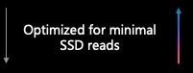

DiskANN – Vector Index for Performance and Accuracy
Highly performant, scalable, and accurate index for vectors
Superior to IVFLAT and HNSW
Reduced memory footprint by storing vectors on SSD
Compression and quantization improve speed and accuracy of vector search
Accuracy retained as data changed
Vector compression
Optimized storage
Large Vectors
{ D1, D2, D3, D4, D5, …, D99, D100 }
RAM
Compressed vectors
Quantization
SSD
Compressed Vectors
{ D1, D2 .., D100 }
Full vectors + graph

Slide 34
Using DiskANN
Now, let’s dive into DiskANN for your vector data
We can create an index on the vector column, so we can do faster searching on the vector data.
CREATE INDEX embedding_diskann_idx ON listing USING diskann (description_vector vector_cosine_ops)
-- Create DiskANN index to improve search times

Slide 35
Lab Agenda – Find Relevant Cases
5
Search context – Sematic Search
Re-ranker and GraphRAG
3
RAG App
4
Search context –
Pattern Matching
2
US Caselaw Dataset
1
Notes:
Make this more descriptive:
And sets the expectations.
Show a visual with growth of search:
All the way to to Sematic -> Reranker and Graph.
Add Semantic Reranker
Add Graph RAG – Give them the query

Slide 36
Advanced Retrieval Technique #1 - Semantic Reranker
A reranker improves the relevance of search results.
It takes an initial set of results generated and reorders them based on additional criteria or more sophisticated models
semantic AS (
SELECT *
FROM semantic_relevance(query, 50)
-– Call re-ranker model
),
semantic_ranked AS (
SELECT semantic.relevance::DOUBLE PRECISION AS relevance,
FROM vector
JOIN semantic ON vector.vector_rank = semantic.ordinality
ORDER BY semantic.relevance DESC
)

Slide 37
Vector Search Results
Recall = 40%
 | Legal Case | Relevant
1 | Le Vette v. Hardman Estate | True
2 | Uhl Bros. v. Hull | True
3 | Woolworth Co. v. City of Seattle | True
4 | Stevens v. King County | True
5 | Wilkening v. Watkins Distributors, Inc | False
6 | Strickland v. City of Seattle | False
7 | King County v. Boeing Co. | False
8 | DeHoney v. Gjarde | False
9 | Evans v. Seattle | False
10 | Arnold-Evans Co. v. Hardung | False

Slide 38
Semantic Ranker Results
Recall = 60%
 | Legal Case | Relevant
1 | Uhl Bros. v. Hull | True
2 | Le Vette v. Hardman Estate | True
3 | Pappas v. Zerwoodis | True
4 | Wilkening v. Watkins Distributors, Inc. | True
5 | Bach v. Sarich | True
6 | Conradi v. Arnold | True
7 | Brant v. Market Basket Stores, Inc. | False
8 | Martindale Clothing Co. v. Spokane & Eastern Trust Co. | False
9 | Tailored Ready Co. v. Fourth & Pike Street Corp. | False
10 | Burns v. Dufresne | False

Slide 39
Advanced Retrieval Technique #2 - GraphRAG
GraphRAG uses knowledge graphs to improve results in complex scenarios.
We use graph queries to get more relevant information that leverages the relationships between entities .
graph AS (
SELECT * from semantic_ranked
JOIN cypher('case_graph', $$
MATCH ()-[r]->(n)
RETURN n.case_id, COUNT(r) AS refs
$$) as graph_query(case_id TEXT, refs BIGINT)
ON semantic_ranked.id = graph_query.case_id
)

Slide 40
GraphRAG Search Results
Recall = 70%
Legal Case | Relevant
Stuart v. Coldwell Banker | True
Laurelon Terrace Inc v. City of Seattle | True
Jorgensen v. Massart | True
Thomas v. Housing Authority | True
Foisy v. Wyman | True
Tope v. King County | True
Le Vette v. Hardman Estate | True
Wood v. City of Tacoma | False
Quinn v. Peterson & Co | False
Schedler v. Wagner | False

Slide 41
Query: Semantic Ranker + Graph
WITH
embedding_query AS (
SELECT azure_openai.create_embeddings('text-embedding-3-small', query)::vector AS embedding
),
vector AS (
SELECT cases.id, RANK() OVER (ORDER BY description_vector <=> embedding) AS vector_rank
FROM cases, embedding_query
WHERE (cases.data#>>'{court, id}')::integer IN (9029, 8985)
-- Washington Supreme Court (9029) or Washington Court of
-- Appeals (8985)
ORDER BY description_vector <=> embedding
LIMIT 50
),
semantic AS (
SELECT *
FROM semantic_relevance(query, 50)
),
semantic_ranked AS (
SELECT semantic.relevance::DOUBLE PRECISION AS relevance,
FROM vector
JOIN semantic ON vector.vector_rank = semantic.ordinality
ORDER BY semantic.relevance DESC
),
graph AS (
SELECT * from semantic_ranked
JOIN cypher('case_graph', $$
MATCH ()-[r]->(n)
RETURN n.case_id, COUNT(r) AS refs
$$) as graph_query(case_id TEXT, refs BIGINT)
ON semantic_ranked.id = graph_query.case_id
),
graph_ranked AS (
SELECT RANK() OVER (ORDER BY graph.refs DESC) AS graph_rank
FROM graph ORDER BY graph_rank DESC
),
rrf AS (
SELECT
COALESCE(1.0 / (60 + graph_ranked.graph_rank), 0.0) +
COALESCE(1.0 / (60 + semantic_ranked.semantic_rank), 0.0)
AS score,
semantic_ranked.*
FROM graph_ranked
JOIN semantic_ranked ON graph_ranked.id = semantic_ranked.id
ORDER BY score DESC
LIMIT 20
)
SELECT * FROM rrf;

Slide 42
DEMO Graph Search

Slide 43



GraphRAG Solution Accelerator for Postgres
Preview
Overview
Legal Research Copilot app
U.S. Case Law dataset (0.5 million cases)
Available Now!
Blog: aka.ms/pg-graphrag
Repo: aka.ms/pg-graphrag-repo
GraphRAG
Summarization
Data
Graph
Apache AGE
extension
Azure Database for PostgreSQL
embeddings
OpenAI
Graph + vector database
Vector search + graph query
User query
Prompt + context
“Water leaking from the floor above…”
Chat
This Lab: aka.ms/pg-ai-demo

Slide 44

Security
Azure Database for PostgreSQL: AI-Ready for Enterprise Applications
Intelligent performance
AI
Global reach
Extensions
Rich indexing
Compliance
JSONB
Ecosystem integration
Full text search
Geospatial
Rich Data types
Scale up & out
Constraints
Extension support
ACID
High Availability
Management Automation

Slide 45

“AI isn't the future, It’s already here.”
Notes:
CLOSING SLIDE

